Slide 1
Counters
Studio 5000
© 2014 John Sefcovic.

Slide 2
Counters
A Counter tracks events and can control other outputs.
An Up Counter increments in value.
A Down Timer decrements in value.
There are two Counter instructions.
Counter Up (CTU)
Counter Down (CTD)

Slide 3
Counters
The Counter Instructions are outputs.
The Counter changes value on a false-to-true transition of the rung event.
The Counter uses a PRESET value to determine the value to count to.
The Counter uses an ACCUMULATED value to track the transitions.
The Counter uses a STATUS BIT to indicate when the PRESET value is at a value in relationship to the ACCUMULATED value.
The Counters STATUS BIT state is used to control an output in the process or application.
The Counter will continue tracking events past the ACCUMULATED value.

Slide 4
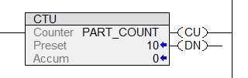
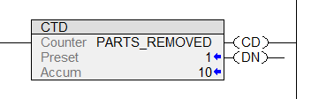

Counters
The Counter Up (CTU), Counter Down (CTD), and Reset (RES) instructions in Studio 5000.
Counter Up (CTU)
Counter Down (CTD)
Reset (RES)

Slide 5
Counters
The Counter Up (CTU), Counter Down (CTD), and Reset (RES) instructions in Studio 5000.
Tags are defined as COUNTER Data Type.

Slide 6
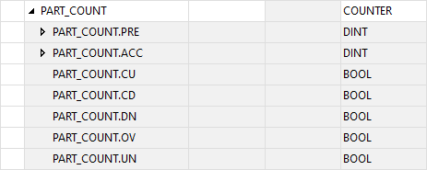
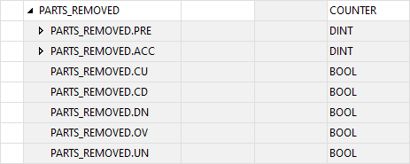
Counters
The COUNTER data uses the Preset, Accumulated, and Status Bits are associated with the Tag.

Slide 7
Up Counter
COUNTER UP (CTU)
The Counter Up (CTU) is an output instruction that will turn on a controlled output when the accumulated value is greater than or equal to the preset value.
The greater than or equal to value will result in the Done bit being set. The Done bit may be used to control other logic.
When the rung transitions from false to true, the counter accumulated value increments by one.

Slide 8
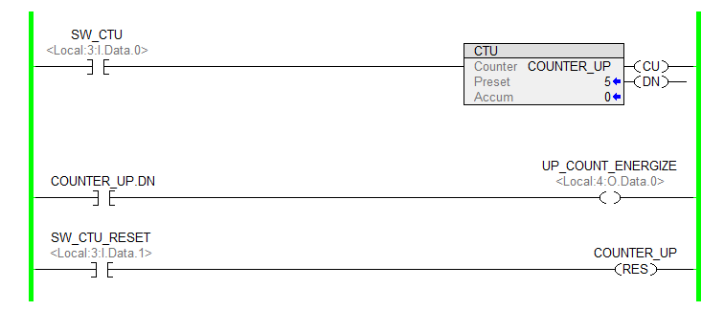
Up Counter
Initial rung conditions and Preset and Accumulated values.
ACCUMULATED VALUE
UP COUNTER ENABLE BIT
DONE BIT
ZERO
RESET
RESET

Slide 9
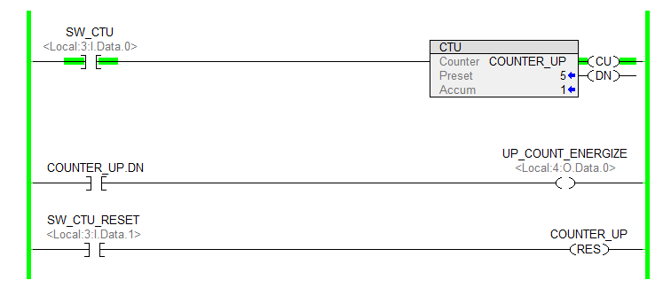
Up Counter
When the rung transitions from FALSE to TRUE, the Accumulated value for the counter does increment.
ACCUMULATED VALUE
UP COUNTER ENABLE BIT
DONE BIT
INCREMENTS
SET
RESET

Slide 10

Up Counter
When the rung returns to FALSE, the Accumulated value for the counter does not increment.
ACCUMULATED VALUE
UP COUNTER ENABLE BIT
DONE BIT
UNCHANGED
RESET
RESET

Slide 11
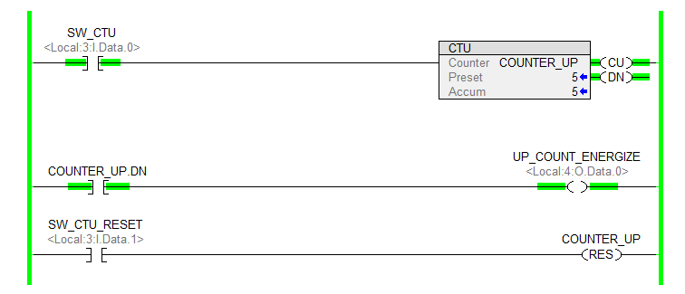
Up Counter
When the rung transitions from FALSE to TRUE, the Accumulated value for the counter does increment. When the Accumulated value is greater than or equal to the Preset value, the Done status bit is set.
ACCUMULATED VALUE
UP COUNTER ENABLE BIT
DONE BIT
INCREMENTS
SET
SET

Slide 12
Up Counter
When the rung is TRUE, the Reset (RES) instruction returns the
Counter Up (CTU) with the same Tag Accumulated value to zero.

Slide 13
Up Counter
The Up Counter (CTU) and the Reset (RES) instructions have the same Tag.

Slide 14
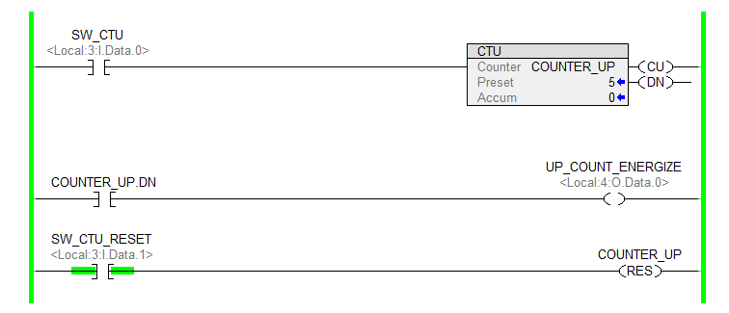
Up Counter
When the rung with the addressed Reset (RES) is TRUE, the Accumulated value returns zero.
The Done status bit is reset.

Slide 15
Down Counter
DOWN COUNTER (CTD)
The Counter Down (CTD) is an output instruction that will turn on a controlled output while the accumulated value is greater than the preset value.
The accumulated value is greater or equal to the preset value will result in the Done bit being set. The Done bit may be used to control other logic.
When the rung transitions from false to true, the counter accumulated value decrements by one.

Slide 16
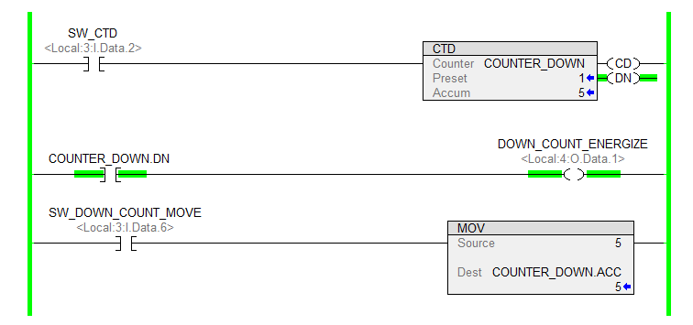
Down Counter
Initial rung conditions and Preset and Accumulated values.
ACCUMULATED VALUE
DOWN COUNTER ENABLE BIT
DONE BIT
ZERO
RESET
SET

Slide 17
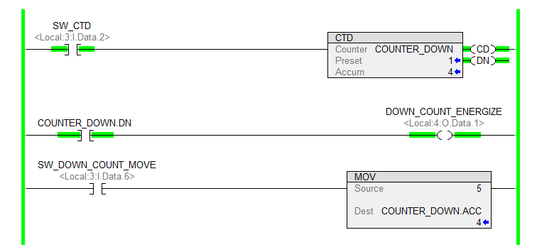
Down Counter
When the rung transitions from FALSE to TRUE, the Accumulated value for the counter does decrement.
ACCUMULATED VALUE
DOWN COUNTER ENABLE BIT
DONE BIT
DECREMENT
SET
SET

Slide 18
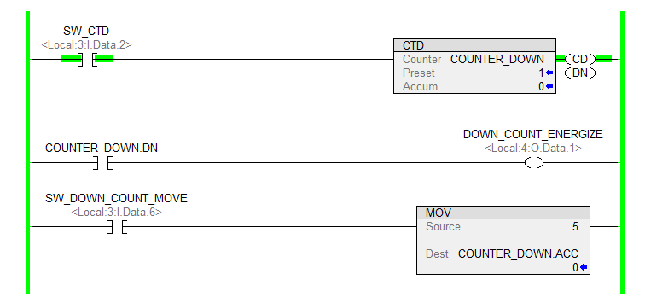
Down Counter
When the rung transitions from FALSE to TRUE the Accumulated value for the counter does decrement and when the Accumulated is less than Preset the Done bit is reset.
ACCUMULATED VALUE
DOWN COUNTER ENABLE BIT
DONE BIT
DECREMENT
SET
RESET

Slide 19
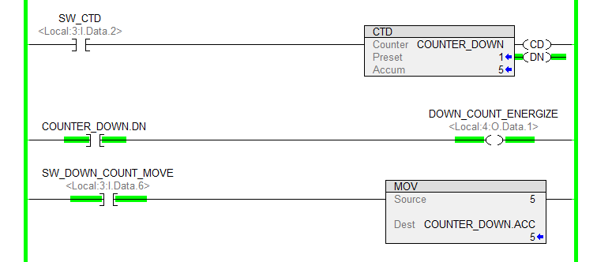
Down Counter
The DONE status bit is SET when the Accumulated value is greater than the Preset value.
A Data Handling instruction would be used to move the decrement count value into the Accumulated value.
The Reset (RES) could not be used, because the Accumulated would be returned to zero.

Slide 20
Down Counter
Up-Down Counter is created by combining an Up Counter with a Down Counter.
  Both counters use the same Counter Data Type Tag.
  The counters are controlled by independent inputs.
  The .DN status bit is controlled by the Up Counter.

Slide 21
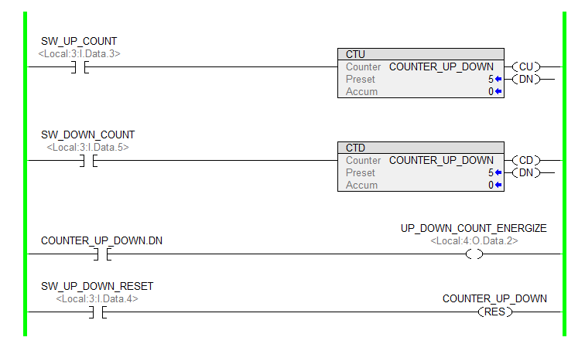
Down Counter
The Up Counter and Down Counter are assigned the same Tag.
The Up Counter is combined with a Down Counter to create an Up - Down Counter.

Slide 22
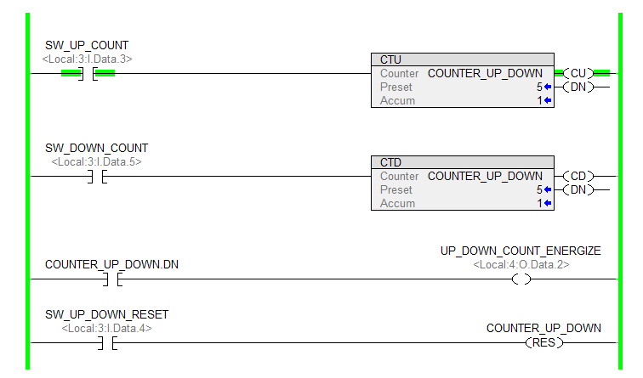
Up - Down Counter
The Up Counter increments the count.
Both Counters use the same Tag and the Preset and Accumulated values are the same.

Slide 23

Up - Down Counter
The Accumulated value is at 3.

Slide 24
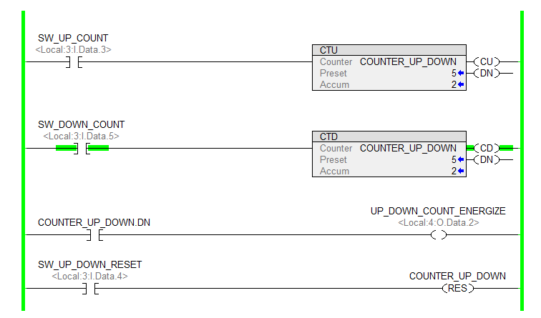
Up - Down Counter
The Down Counter decrements the count to 2.

Slide 25
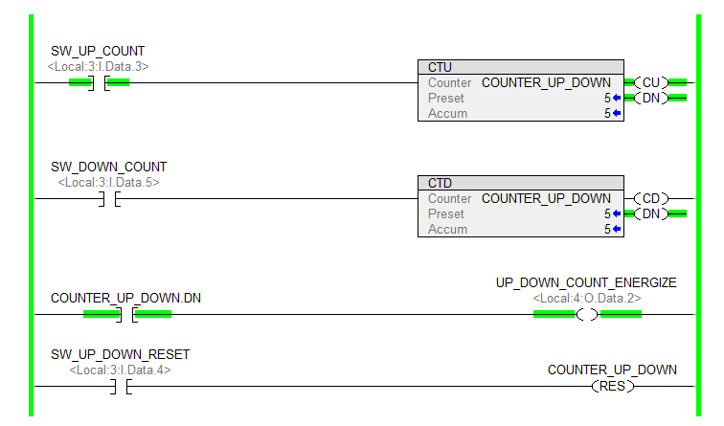
Up - Down Counter
The when the Accumulated is equal to or greater than the Preset, the Done bit is SET.

Slide 26
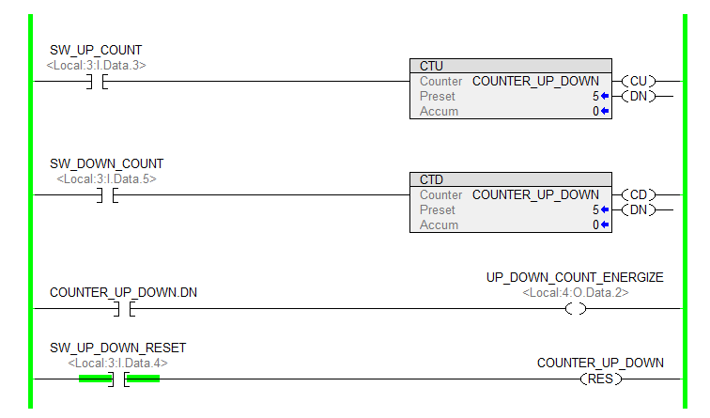
Up - Down Counter
The Reset returns the Accumulated value returns zero.

